Slide 1
PROBLEM STATEMENT
Approximately 210 million people in India require mental health intervention. According to the National Mental Health Survey,treatment gap reported for any mental disorders is around 83%.
Recognizing this we can enhance Mental Health Care in India through AI: Developing effective AI-driven solutions to improve mental health diagnosis, treatment, and support.

Slide 2
ABSTRACT
Globally, one in four individuals grapples with mental illness, with India burdened by 60 to 70 million affected.
AI presents a groundbreaking solution, leveraging machine learning and natural language processing to revolutionize mental health care. The project aims to develop a chatbot for digital therapeutics, providing virtual assistance and preemptive interventions. This AI-driven tool seeks to offer companionship, guidance, and enhanced support in navigating mental well-being challenges, aiming to address India’s mental health crisis effectively.

Slide 3
LITERATURE SURVEY - BASE PAPER-1
Paper : Mental Health Chatbot
Published by & Year: International Journal of Research Publication and Reviews, October 2023.
About paper:
This project aims to develop a virtual CHAT BOT using Python that allows users to get information from the chatbot about mental health . A chatbot based conversational user interface fits into this space. The user can interact with them via graphical interfaces or widgets, and the trend is in this direction. On a college’s website, one often doesn’t know where to search for some kind of information. It becomes difficult to extract information for a person who is not a student or employee there. The solution to these comes up with a chatbot by providing information. Chat bots are an intelligent system being developed using artificial intelligence (AI) and natural language processing (NLP) algorithms.
Keywords: Chatbot natural language processing (NLP) and artificial intelligence(AI).

Slide 4
LITERATURE SURVEY - BASE PAPER-2
Paper :Transformer vs. RASA Model: A Thorough Attempt To Develop Conversational Artificial Intelligence To Provide Automated Services To University Disciples
Year: International Journal of Research Publication and Reviews, October 2023.
About paper:
Over the last decade, chatbots, or conversational agents, have become integral to internet services, providing comprehensive responses to user queries and fostering community interaction.We propose developing an interactive chatbot capable of learning from student interactions. Through extensive research, we've identified two models, the Transformer and RASA, for comparison in terms of accuracy and effectiveness in chatbot development. By evaluating their strengths and weaknesses, we aim to enhance chatbot performance and functionality, ultimately improving accessibility and learning outcomes for students. This research will contribute to streamlining information retrieval processes in educational settings and optimizing student support services .
Keywords: Chatbots, Conversational agents, Artificial intelligence models, Transformer, RASA model, Accuracy, Chatbot development, Accessibility, Learning, Conceptualization.

Slide 5
EXISTING SYSTEMS
Traditional mental healthcare relies on costly, time-consuming, and sometimes stigmatizing in-person therapy sessions.
Hotlines and crisis helplines offer valuable support but often struggle with high demand and lack capacity for ongoing assistance or follow-up care.
The mental health apps market was valued at USD 4.49 billion in 2019 and is projected to grow from USD 0.2 billion in 2023 to USD 17.5 billion by 2031.
Many online platforms and apps offer mental health resources and self-help tools, but they may lack personalized guidance.
Chatbot solutions like Woebot, Wysa, and Tess support various mental health issues through text-based interactions.

Slide 6
LIMITATIONS
Existing chatbots lack nuanced language understanding and context, reducing effectiveness. Mental healthcare apps often lack personalization for diverse needs and backgrounds. Some apps provide inaccurate information, leading to potential harm. Overemphasis on self-help may hinder access to professional support. Not all apps are evidence-based, diminishing effectiveness. Expensive and Exclusive. Proliferation of apps leads to service fragmentation, hindering access to comprehensive care.

Slide 7
PROPOSED SYSTEM
Implementing advanced NLP using Rasa framework to build a conversational text-based rule-based AI. Rasa is open source and enables best user customization features to cater our needs.
No use of generative or reinforcement learning in order to reduce harmful hallucinations which is problem in healthcare services.
Enable personalization by authentication and user defined recommendation for individuals basing test results.
Handles privacy concerns .
Cost free, accessible 24*7,reliable digital services.

Slide 8
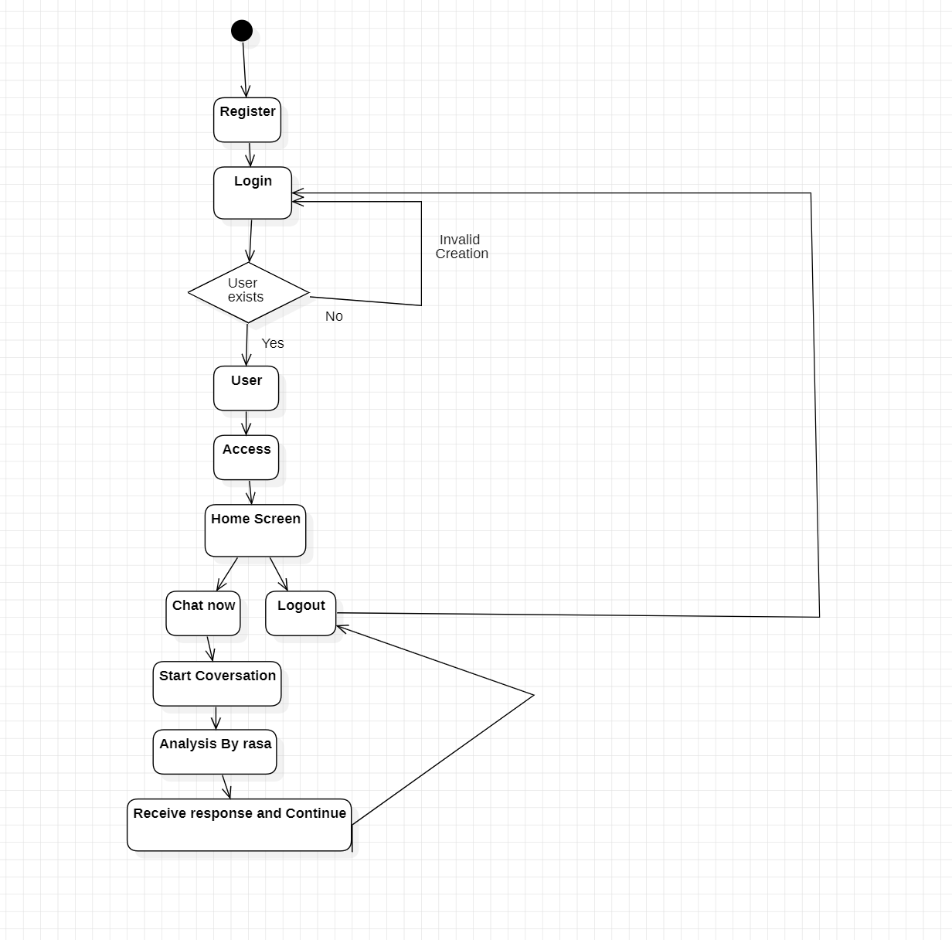
BLOCK DIAGRAM

Slide 9
MODULES
User Authentication Module
Chatbot Interface Module
Database Module
Handles user authentication using Flask framework(includes registration and login. Privacy and personalization.
Enables the user to interact with the chatbot: ask and receive response. Uses Rasa framework.
DB module handles data storage, retrieval , and privacy.
User / Item module.

Slide 10

DESIGN
MODEL INTEGRATION
Scope & Requirement
Identify the Input’s
Understanding UI Elements
Craft and Build Interaction
Testing
FLASK SERVER
Setup flask application
Database Models
Templates
Authentication
Routing & Views
MODEL INTEGRATION
Dashboard and Chatbot Integration

Slide 11
FLOWCHART
User Sign-up
User Login
User verified and allowed access
User Input
Flask server posts
Logout
End conversation
BOT response
RASA Core
RASA NLU

Slide 12
PSEUDOCODE
Import necessary libraries and dependencies(Rasa & Flask)
Define Database Models
Define App Routes:
@app.route:(‘/logout’):
def logout():
return render_template(‘logout’);
Rasa Chatbot Configuration:
nlu.yml
domain.yml
Stories.yml
Train Chatbot : rasa train
Dashboard and Chatbot Integration:
Start Flask and Rasa server:
rasa run --enable-api --cors “*” –debug
python main.py

Slide 13
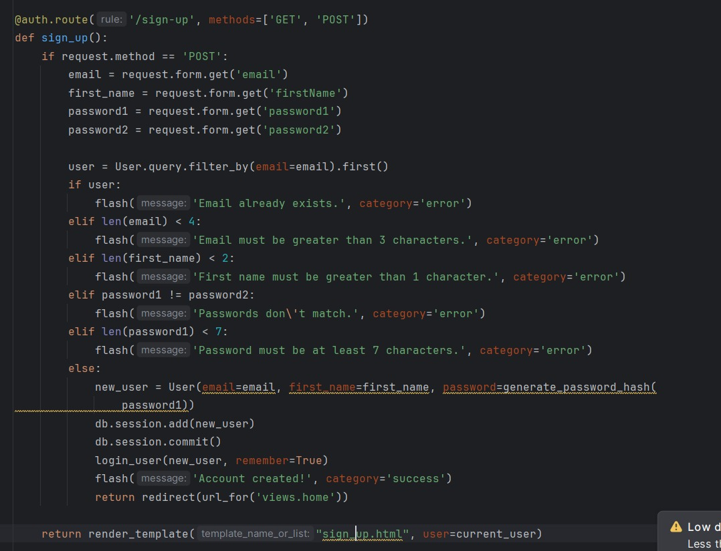
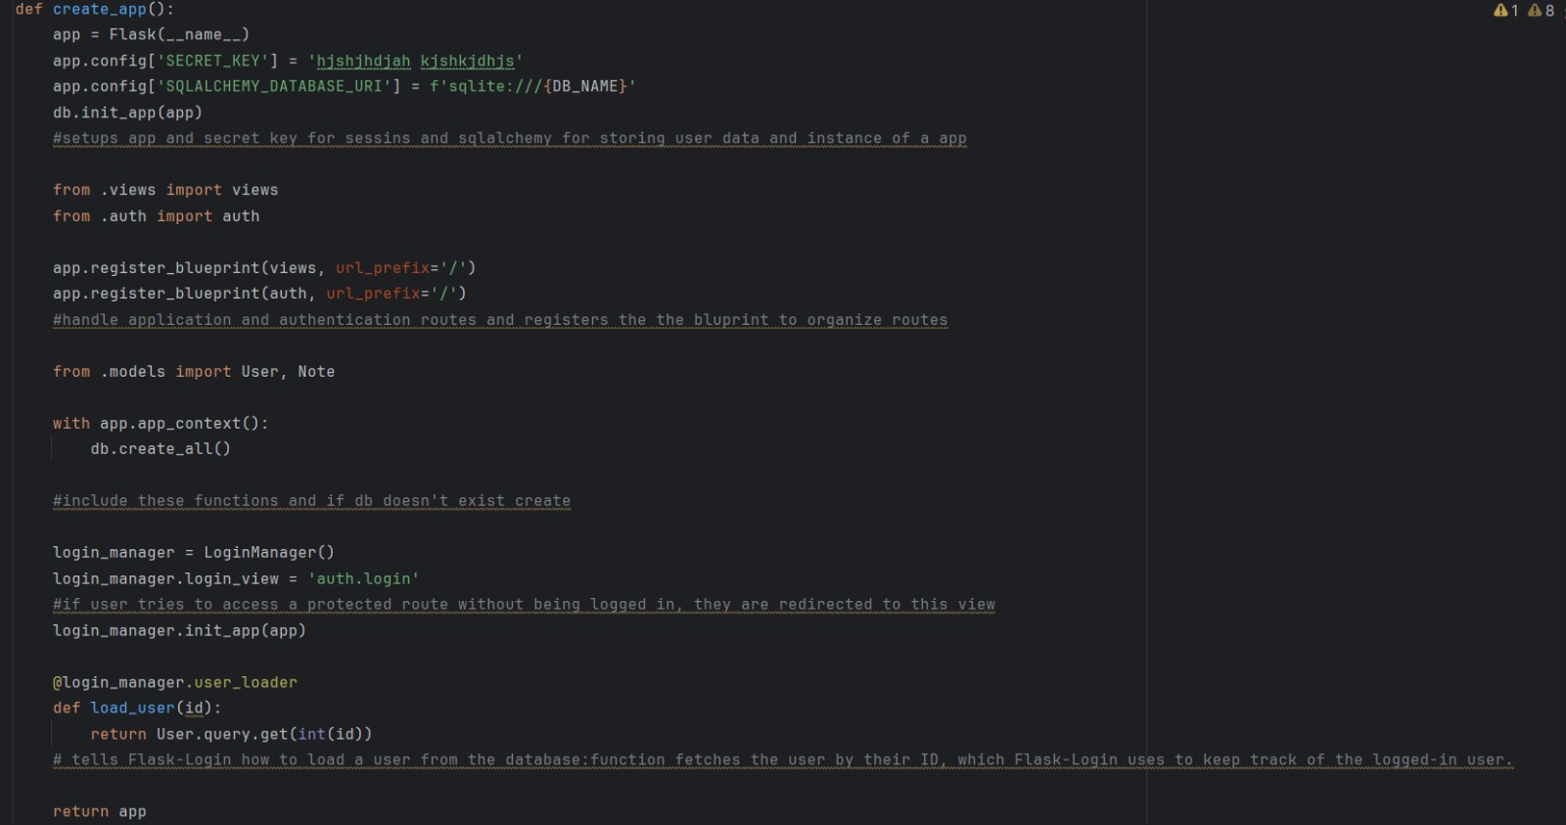
Flask Application

Slide 14
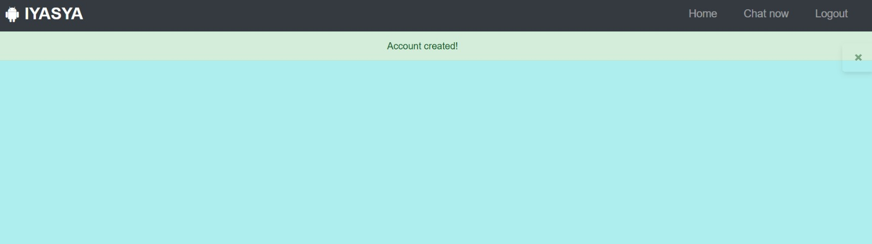
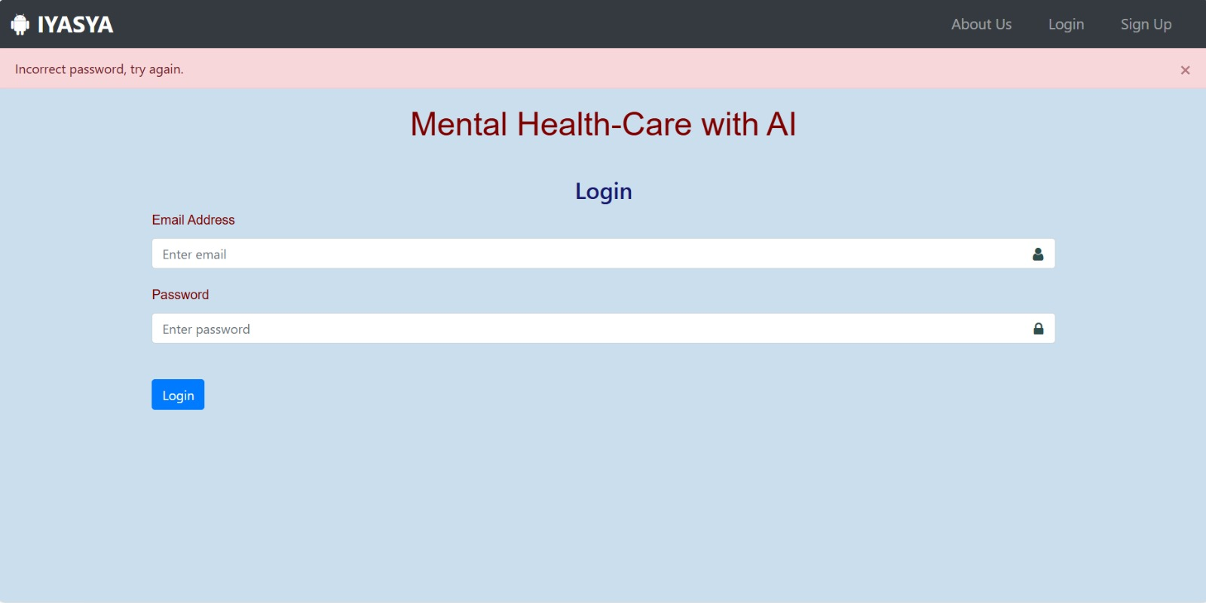
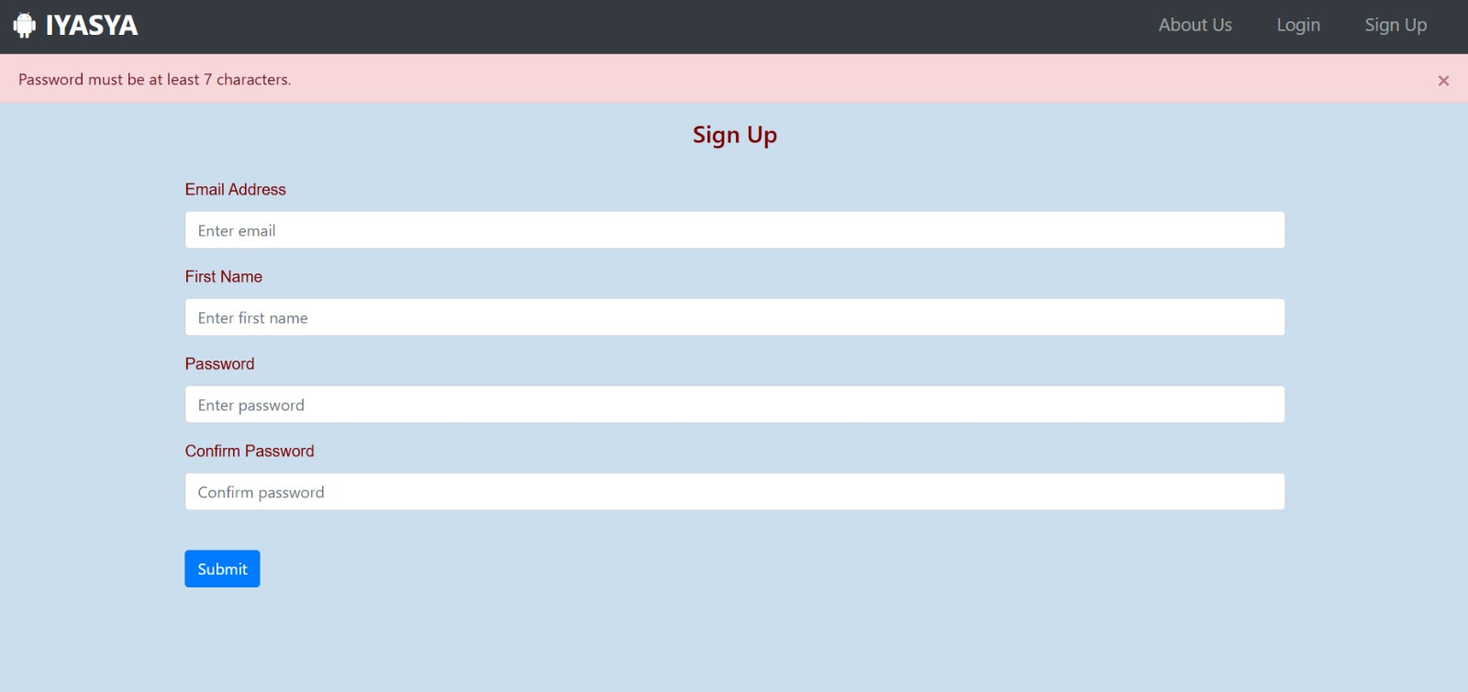

Slide 15
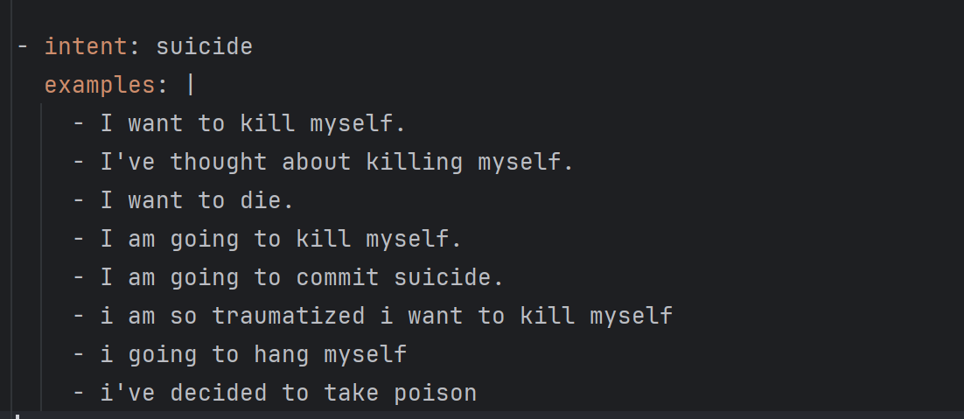
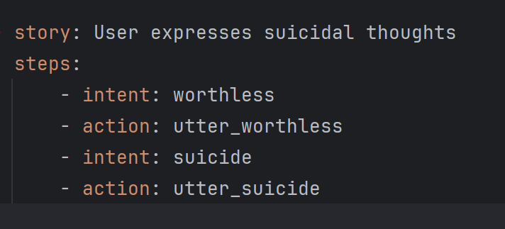
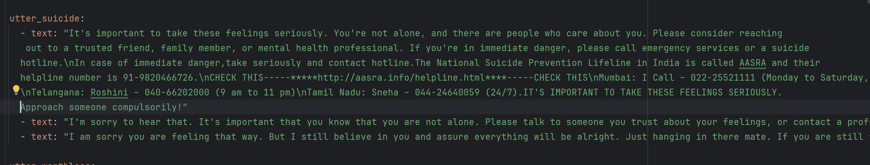
Bot Training

Slide 16
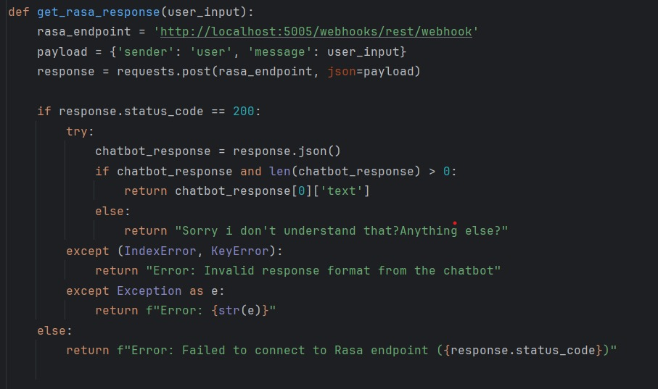
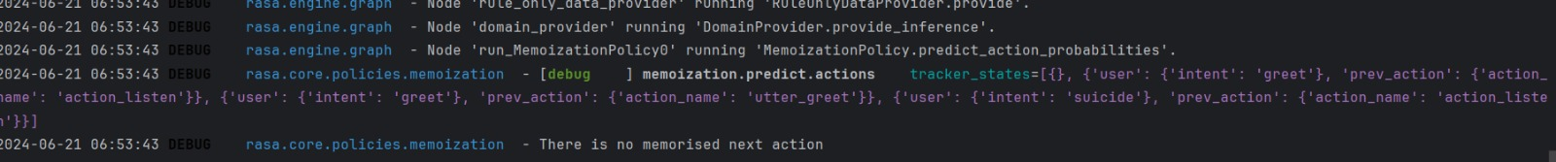
Integration with Flask

Slide 17
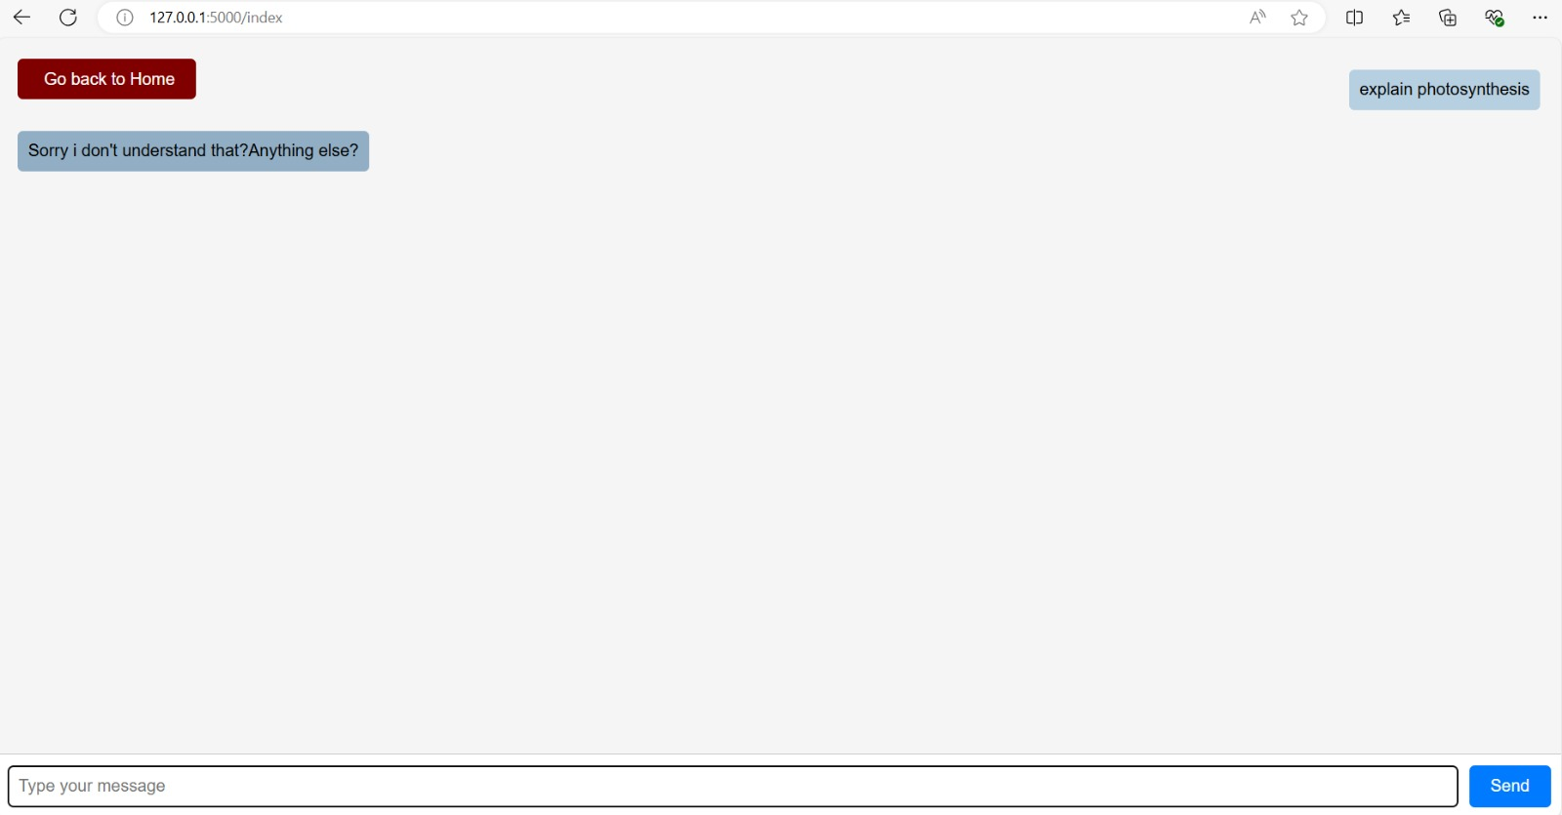

Slide 18
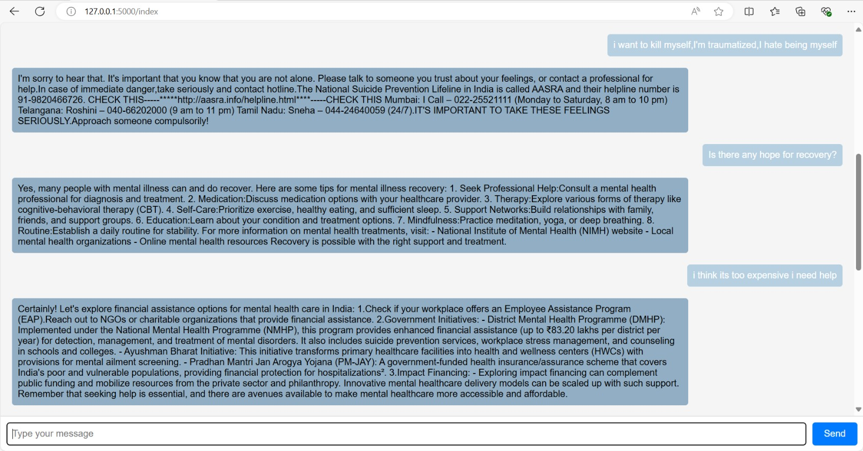

Slide 19
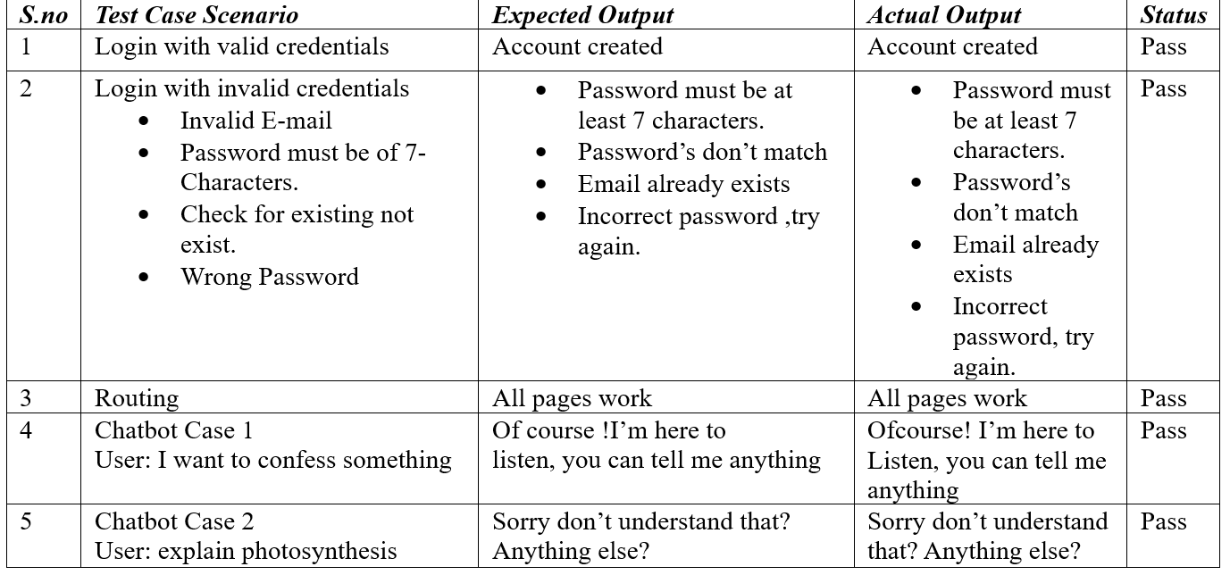
TEST CASES

Slide 20
CONCLUSION & FUTURE SCOPE
In conclusion, this project has successfully demonstrated the integration of Rasa and Flask to create a robust conversational AI application
Support for Therapists and Clinicians
Assessment modules
Integration with Wearable Technology
Virtual Counsellors and Assistants
Journalling
Community
LLM INTEGRATION

Slide 21
REFERENCES
https://ajcse.info
https://flask.palletsprojects.com
https://rasa.com
https://www.w3schools.com › html HTML Styles CSS - W3Schools
https://www.w3schools.com › css CSS Tutorial - W3Schools
https://www.xaqt.com/blog/mastering-rule-based-systems/
https://medium.com
https://woebothealth.com/why-generative-ai-is-not-yet-ready-for-mental-healthcare/
https://www.analyticsvidhya.com

